Slide 1

6.0
BragBoard
Internal Employee Recognition Wall
Under the Guidance of:
Swaraj Aalla

Slide 2
PROBLEM STATEMENT
In many organizations, employee appreciation is informal, inconsistent,
and often goes unnoticed across teams.
There is a need for a centralized platform that encourages recognition,
engagement, and positive workplace culture.

Slide 3
PROPOSED SOLUTION – BRAGBOARD
• A company-wide digital recognition wall
• Employees can post shout-outs for teammates
• Tagging, reactions, and comments for engagement
• Admin moderation and analytics dashboard

Slide 4





TECHNOLOGY STACK
Used to build a dynamic and responsive user interface for posting shout-outs, viewing feeds, and interacting with reactions and comments.
Provides utility-first styling to design a clean, modern, and consistent UI with faster development and responsive layouts.
Handles backend business logic and REST APIs for authentication, shout-out management, comments, reactions, and admin operations.
Ensures secure user authentication and role-based access control using access and refresh tokens.
Stores structured application data such as users, shout-outs, comments, reactions, and admin logs securely and efficiently.

Slide 5
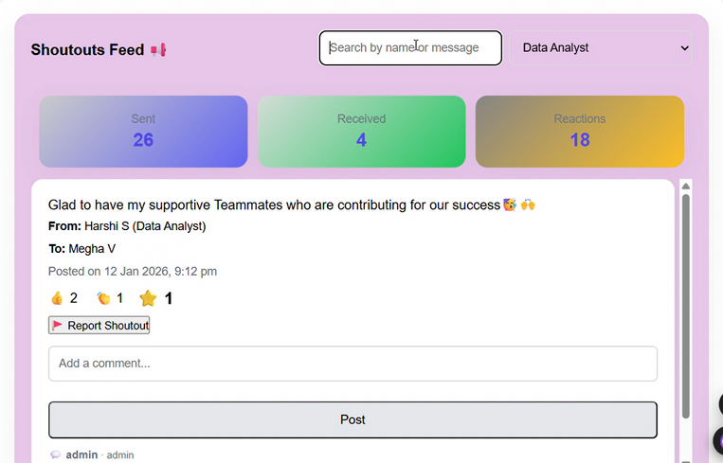
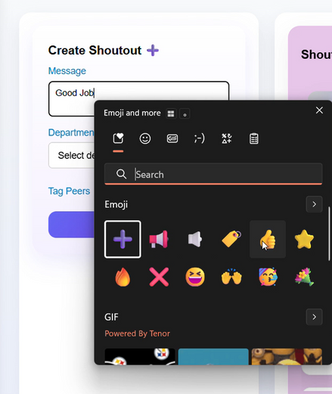
Core Features
1. Employee shout-outs with tagging
2. Multi-recipient appreciation posts
3. Reactions: Like, Clap, Star
4. Commenting system with timestamps
5. Admin dashboard for moderation & insights
System Modules
Module A: User Management & Authentication
Module B: Shout-Out Creation & Feed
Module C: Tagging, Reactions & Comments
Module D: Admin Tools & Analytics

Slide 6
SYSTEM ARCHITECTURE
• Shout-outs UI
• Feed & Comments
• Admin Dashboard
React Frontend
Admin Actions
REST API Layer
  Reports
  Review
  Action Log
• Business Logic
• Role-Based Access (RBAC)
• Moderation Services
JWT Authentication
Fast API Backend
• Users
• Shout-outs
• Comments
• Reactions
• Admin Logs
React frontend communicates securely with FastAPI backend
using JWT-based authentication and PostgreSQL database.
Postgre Sql Data Base

Slide 7
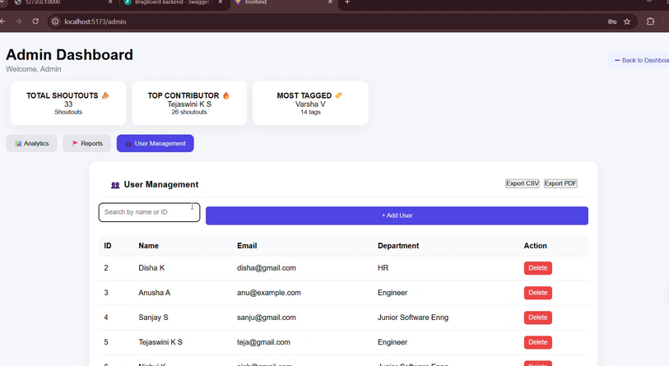
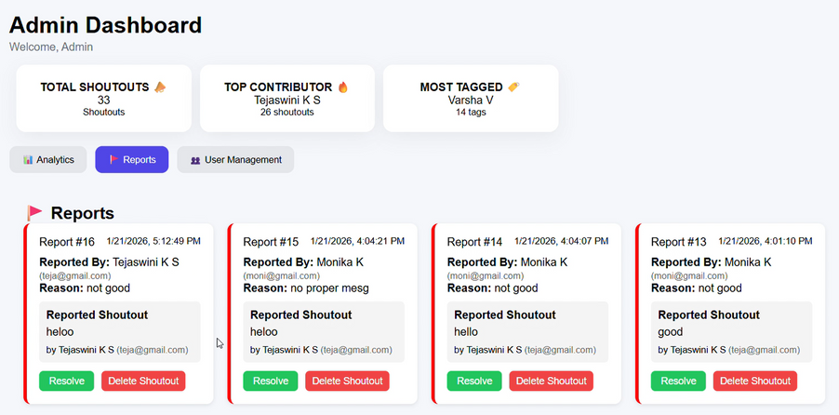
EXPECTED OUTCOMES
• Improved employee engagement and morale
• Transparent recognition across teams
• Real-time appreciation and feedback
• Better admin control and analytics
The user-friendly interface ensures seamless interaction,
encouraging participation and engagement across the organization.

Slide 8
Gamification & Recognition Badges
Introduce badges like Star Performer, Team Player, Rising Star
Advanced Analytics & Insights
Monthly/quarterly engagement reports
AI-Based Sentiment Analysis 🔥
Analyze shout-out messages to detect positive sentiment
Real-Time Notifications
  In-app notifications for new shout-outs and comments
  Email notifications for tagged employees
Advanced Moderation Tools
Automatic detection of inappropriate language
FUTURE ENHANCEMENTS

Slide 9
TeamsTeam
TEAM MEMBERS
A. Jeevesh Srinivas
Tejaswini K. S

Slide 10
Thank You
OPEN FOR QUESTIONS

